Slide 1
Secured Modem

Slide 2
Outline
Introduction
Low Probability of Detection Concept
LPD-based Communication, Navigation and Identification
Signal Intelligence Concept
Satellite SIGINT
Some Experiments by ITB :
Physical Design of Link-16 ( F-16 Data Link )
Chaotic-based Secure Videoconference over Satelite

Slide 3
Introduction

Slide 4
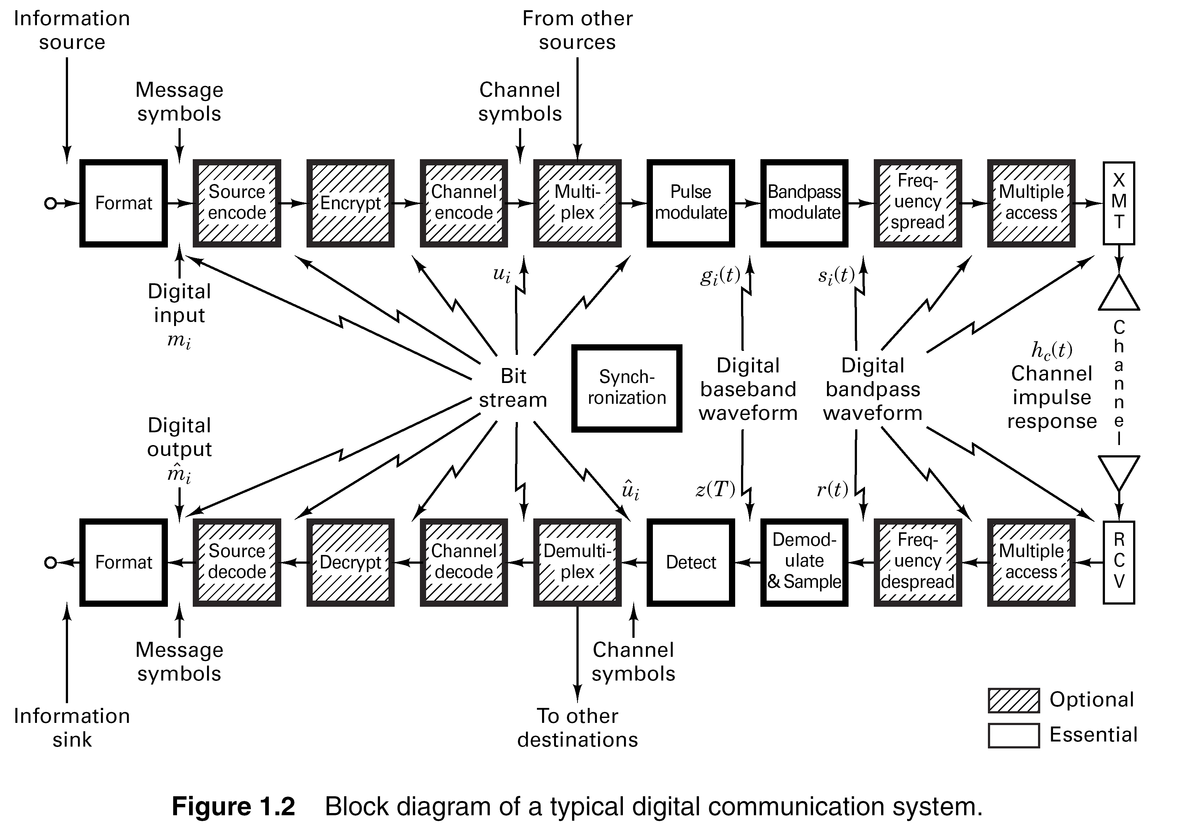
Generic Digital Communication Systems

Slide 5
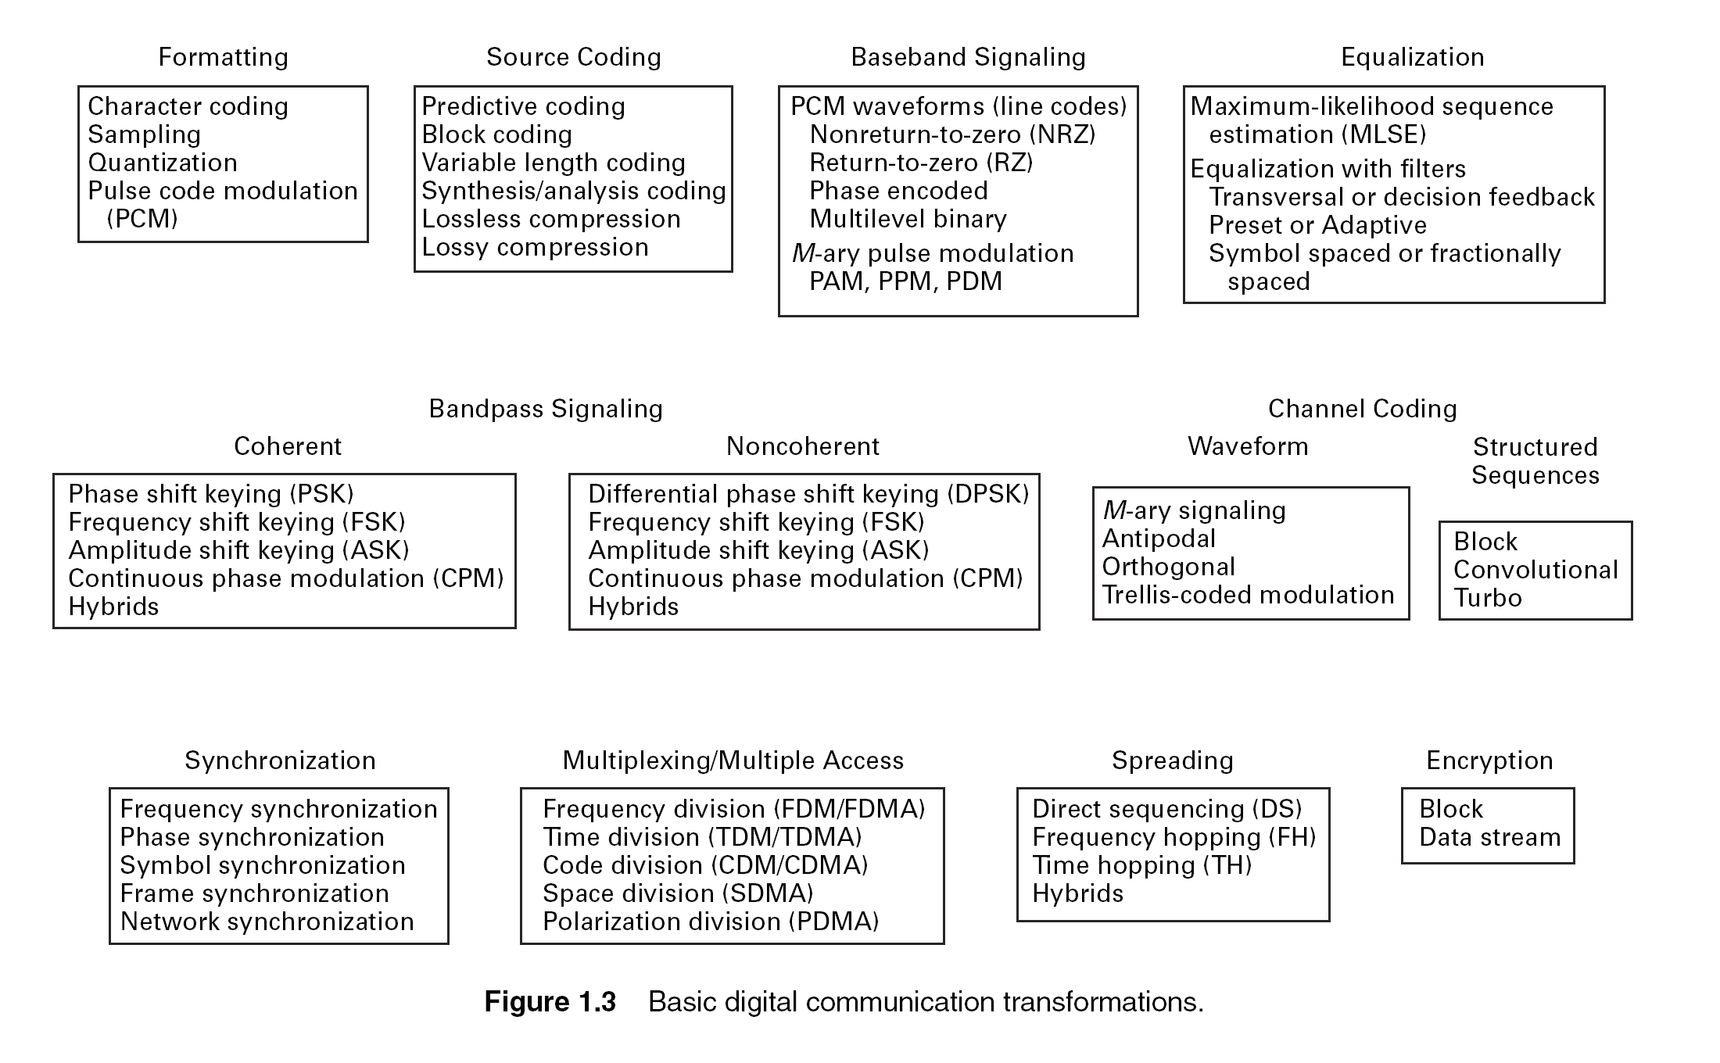
Generic Digital Communication Systems

Slide 6
Why Digital Communications?
Easy to regenerate the distorted signal
Regenerative repeaters along the transmission path can detect a digital signal and retransmit a new, clean (noise free) signal
These repeaters prevent accumulation of noise along the path
Immunity to distortion and interference
Digital communication is rugged in the sense that it is more immune to channel noise and distortion
Hardware is more flexible
Digital hardware implementation is flexible and permits the use of microprocessors, mini-processors, digital switching and VLSI
Easy to Multiplex
Easier and more efficient to multiplex several digital signals
Digital multiplexing techniques – Time & Code Division Multiple Access - are easier to implement than analog techniques such as Frequency Division Multiple Access

Slide 7
Why Digital Communications?
Can combine different signal types – data, voice, text, etc.
Data communication in computers is digital in nature whereas voice communication between people is analog in nature
The two types of communication are difficult to combine over the same medium in the analog domain.
Encryption and privacy techniques are easier to implement
Better overall performance
Digital communication is inherently more efficient than analog in realizing the exchange of SNR for bandwidth
Digital signals can be coded to yield extremely low rates and high fidelity as well as privacy

Slide 8
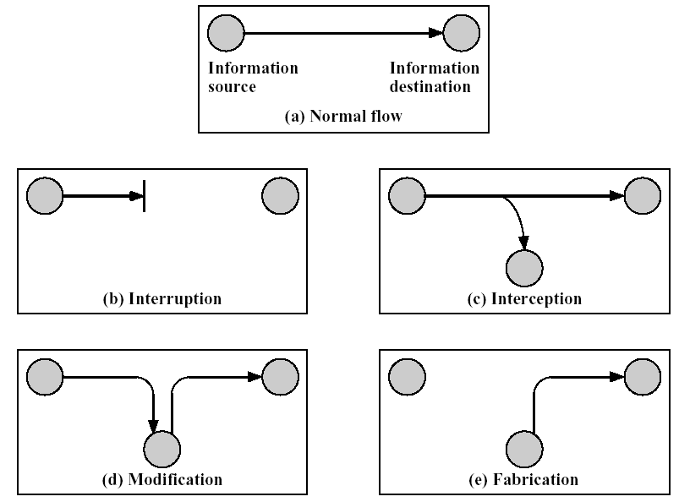
Secure Communications Requirements
Basic Security Requirements:
Confidentiality
Authentication
Integrity
Freshness
Secure Group Management
Availability
availability
confidentiality
integrity
authenticity
Notes:
Confidentiality requirement is needed to ensure that sensitive information is well protected and not revealed to unauthorized third parties.
As in conventional systems, authentication techniques verify the identity of the participants in a communication, distinguishing in this way legitimate users from intruders
Moving on to the integrity objective, there is the danger that information could be altered when exchanged over insecure networks. One of the many attacks launched against sensor networks is the message replay attack where an adversary may capture messages exchanged between nodes and replay them later to cause confusion to the network. Data freshness objective ensures that messages are fresh, meaning that they obey in a message ordering and have not been reused. To achieve freshness, network protocols must be designed in a way to identify duplicate packets and discard them preventing potential mix-up.

Slide 9
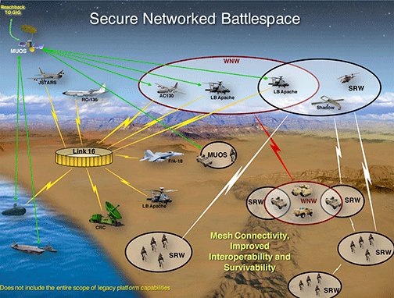
Secure Communications Systems : Military
The success of modern military forces depends a great deal on the effective use of sophisticated radio communication and navigation systems. Historically, the enemy has employed electronic countermeasures (ECM) to detect the presence of these radio signals and either disrupt them or exploit them.
Radio systems can be disrupted by jamming or by locating and destroying them.
On the other hand, exploitation involves using the transmissions for intelligence and counter-intelligence purposes.
Prior to the development of high quality data security and transmission security techniques, it was possible to gather intelligence from the received signals by demodulating and decoding (deciphering) them.
For simple systems it is also possible to "spoof" (or mimic) them to provide false information (counter-intelligence).
Radio transmissions can also be exploited, even when they employ high quality security techniques, by simple radio direction finding (RDF) or position monitoring.

Slide 10
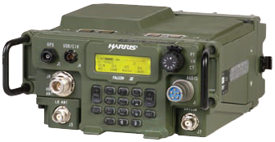
Example of a Military Radio System
Frequency Range
HF (2-30MHz): Long-range (up to 4000 km)
VHF (30-108MHz): Short range ground tactical (up to 50 km)
UHF (225-400MHz): Air-Air and Air-Ground (up to 300 km)
UHF SATCOM (280-320MHz): Worldwide
Wideband Networking (225-2000 MHz): Ranges up to 10 km
Modes of Operation
Voice (push-to-talk)
Data
IP point-to-point data
IP sub-network data
Radio Types
Handheld radios
Manpack / vehicular radios
Soldier radios
Key Fill
DS-101 EKMS
Sovereign/Coalition
Waveforms
US (MIL-STDs) and NATO (STANAGs) interoperable waveforms
Proprietary Harris exportable waveforms
Fixed frequency and anti-jam frequency hopping waveforms
Falcon II/III Radio Platforms
JTRS/SCA SDRs
Exportable SCA-based SDRs
Proprietary SDR
Information Assurance
Programmable INFOSEC
COMSEC
TRANSEC
Software Defined Radio IA

Slide 11
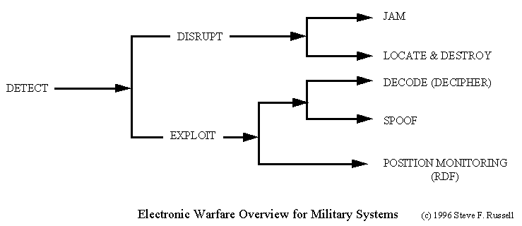
Secure Modem Requirements : LPD Communications
LPD : low probability of detection

Slide 12
Some Terminologies
There are some alternate terminologies used to describe Secure Communications concepts that need to be discussed.
The first is Low Probability of Detection (LPD). LPD requirements are concerned with preventing the enemy from detecting a radio transmission. LPD applies to those techniques which minimize power spectral density and hence detection.
The second is Low Probability of Exploitation (LPE). LPE is concerned with preventing the exploitation of the signal by decoding, spoofing, or position monitoring. LPE design would deny the enemy knowledge of the system, its modulation characteristics, its use, and its users.
The third term is Low Probability of Intercept (LPI) which encompasses both LPD and LPE. LPI is a generic term from which we derive the term anti-intercept.

Slide 13
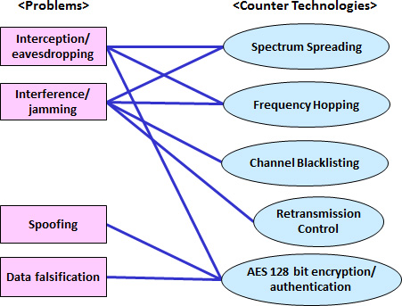
Techniques for Securing a Communications System
Spoofing : A technique used to gain unauthorized access to computers, whereby the intruder sends messages to a computer with an IP address indicating that the message is coming from a trusted host. To engage in IP spoofing, a hacker must first use a variety of techniques to find an IP address of a trusted host and then modify the packet headers so that it appears that the packets are coming from that host.
Falsification : the act of falsifying, or making false; a counterfeiting; the giving to a thing an appearance of something which it is not

Slide 14
LPD Applications on CNI

Slide 15
CNI : Communications, Navigation and Identification
Communications: The ability to be able to communicate by either voice or data link means with cooperative forces, be it wingmen in the same flight of aircraft, airborne command centre or troops on the ground.
Navigation : The science of getting ships, aircraft, or spacecraft from place to place; especially : the method of determining position, course, and distance traveled
Identification : The rules of engagement for a given theatre of operation will necessitate the classification and identification of a target before permis sion to engage is given.

Slide 16
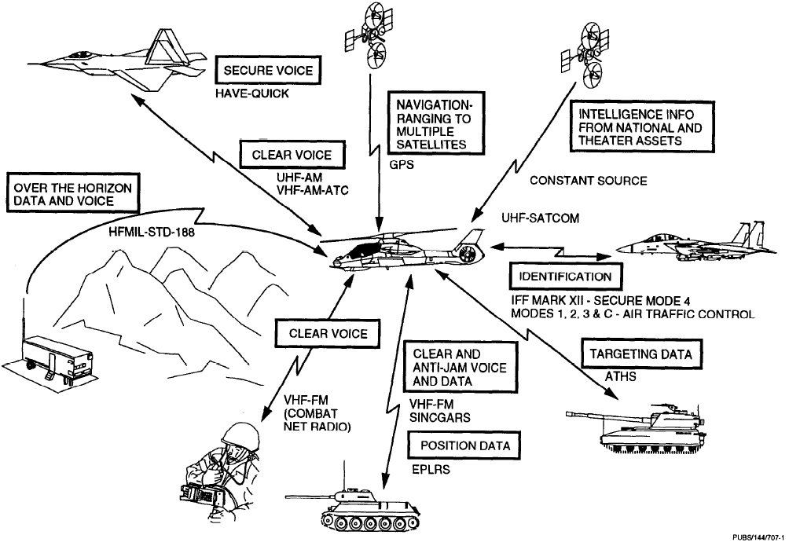
LPD Applications on CNI
Communications :
VHF/UHF Tactical Radios
SINGARS/HAVEQUICK
Navigation :
GPS
TACAN
VOR/DME
Identification:
IFF Mark XII
Secondary Radar

Slide 17
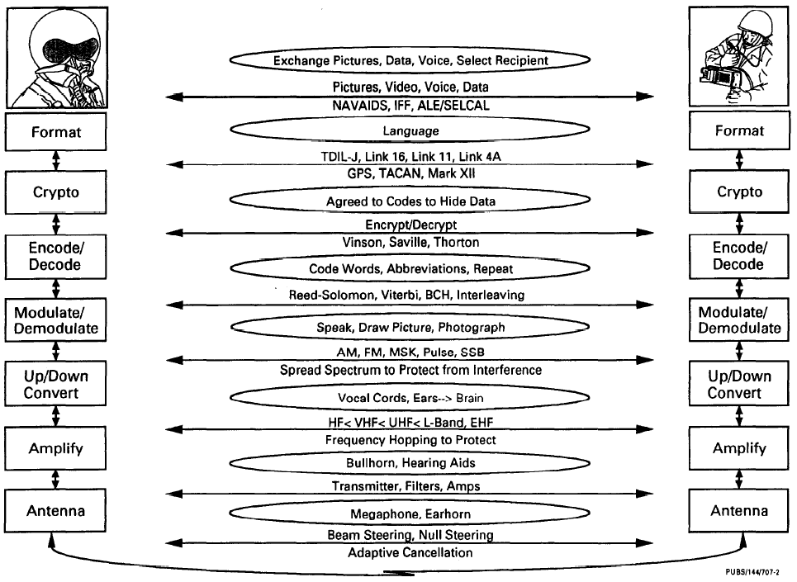
Signal Flow of CNI Systems

Slide 18
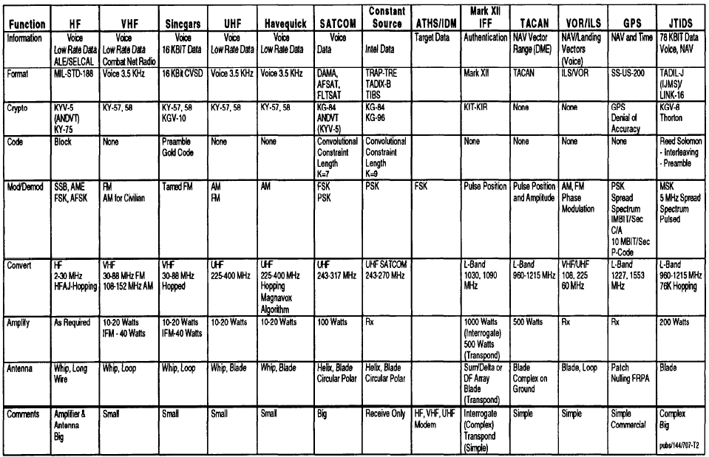
Some Examples

Slide 19
SIGINT (Signal Intelligence) : Secure Communication Challenger

Slide 20
Signal Intelligence
SIGINT = COMINT + ELINT + MASINT
COMINT (COMmunications INTelligence)
Interception of communications between people or machines
ELINT (ELectronics INTelli gence)
Detection and analysis of non-communications electronic transmissions
Electronic Warfare: radiation from electronic systems; jamming radiation
MASINT (Measurement And Signatures INTelligence)
Scientific and technical intelligence obtained by quantitative and qualitative analysis of data (metric data (metric, angle spatial angle, spatial, wavelength wavelength, time dependence modulation time dependence, modulation, plasma and hydromagnetic)
Example : TELINT ( Telemetry Intelligence )

Slide 21
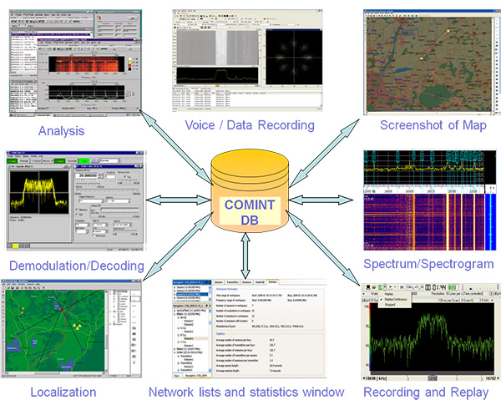
COMINT
Search, DF and intercept
Location fixing of emitters
Signal analysis and classification
Monitoring
Recording
Evaluation and comparison with stored data
Generation of tactical reports

Slide 22
Communication Signal Scenarios
Wide Spectral Coverage ( 1.5 MHz – 18 GHz )
Complex Waveforms (Burst, FH, DS)
Non-Standard Data Formats
High Signal Density
Low SNR Conditions
Both NB and WB Signals (FDM & TDM)
Encrypted Signals
Short Dwell Times

Slide 23
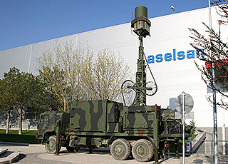
ELINT
ELINT involves actions taken to :
Search
Intercept
Locate
Record
Analysis of radiated EM energy
ELINT Receiver measure :
Angle of Arrival (AOA)
Pulse Width
Pulse Repetion Frequency
Frequency
Time of Arrival
Scan Rate
Location fixing of emitter

Slide 24
Radar Signal Scenarios
Wide Spectral Coverage ( 0.5 – 40 GHz )
Complex Waveforms
Wide PRF Range with Jitter and Stagger – 50 Hz to 500 KHz
Wide Pulse Width Ranges – 50 ns to 500 µs
Variety of Antenna Scans
Short Dwell Times

Slide 25
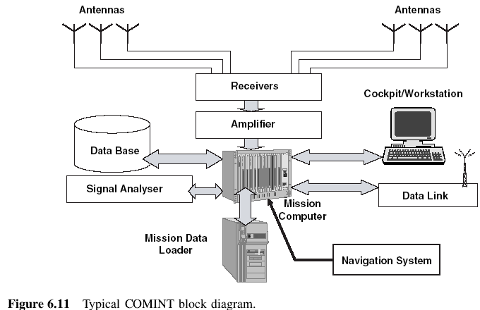
Typical Architecture of COMINT/ELINT

Slide 26
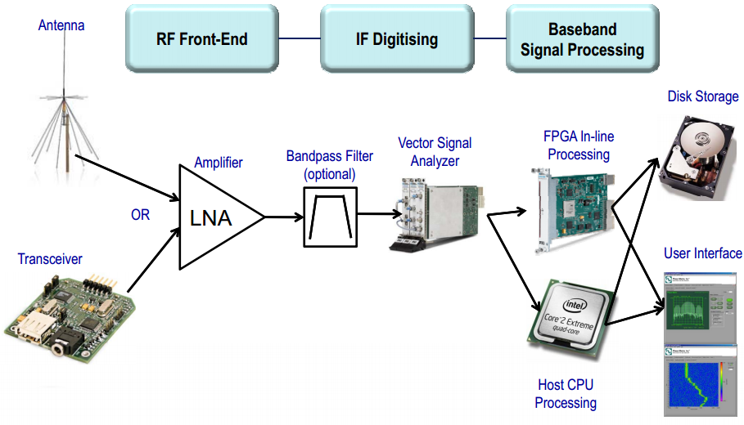
Modern Implementation of COMINT/SIGINT

Slide 27
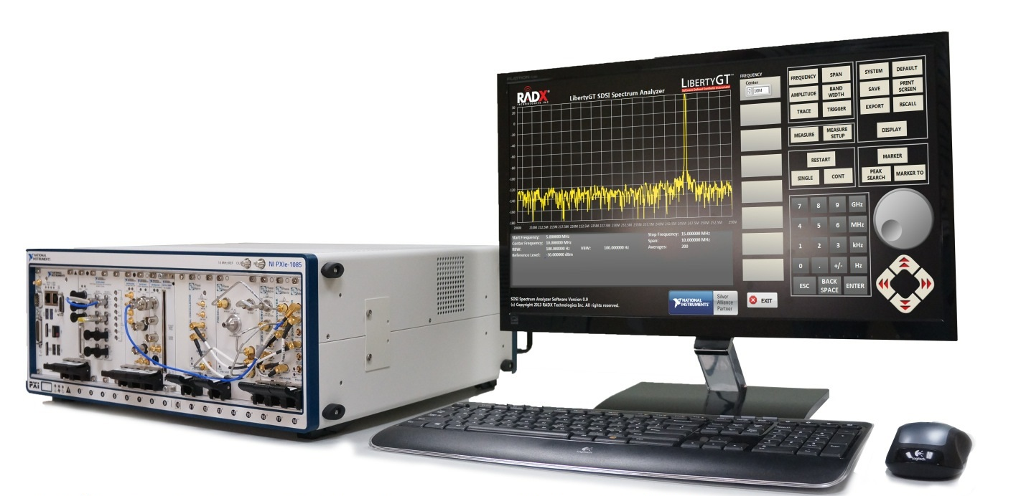
Modern Implementation of COMINT/SIGINT

Slide 28
Satellite SIGINT

Slide 29
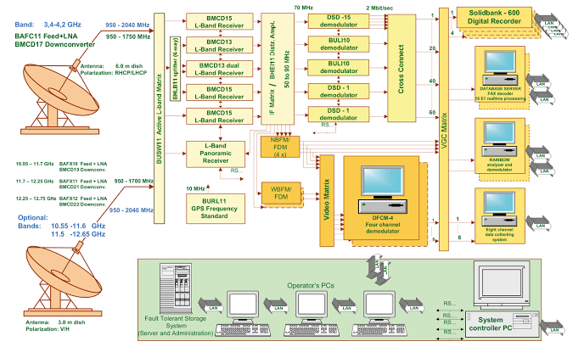
Satellite SIGINT

Slide 30
Echelon
ECHELON is a name used in global media and in popular culture to describe a signals intelligence (SIGINT) collection and analysis network operated on behalf of the five signatory states to the UK–USA Security Agreement :
Australia
Canada
New Zealand
United Kingdom
United States.
It has also been described as the only software system which controls the download and dissemination of the intercept of commercial satellite trunk communications.

Slide 31
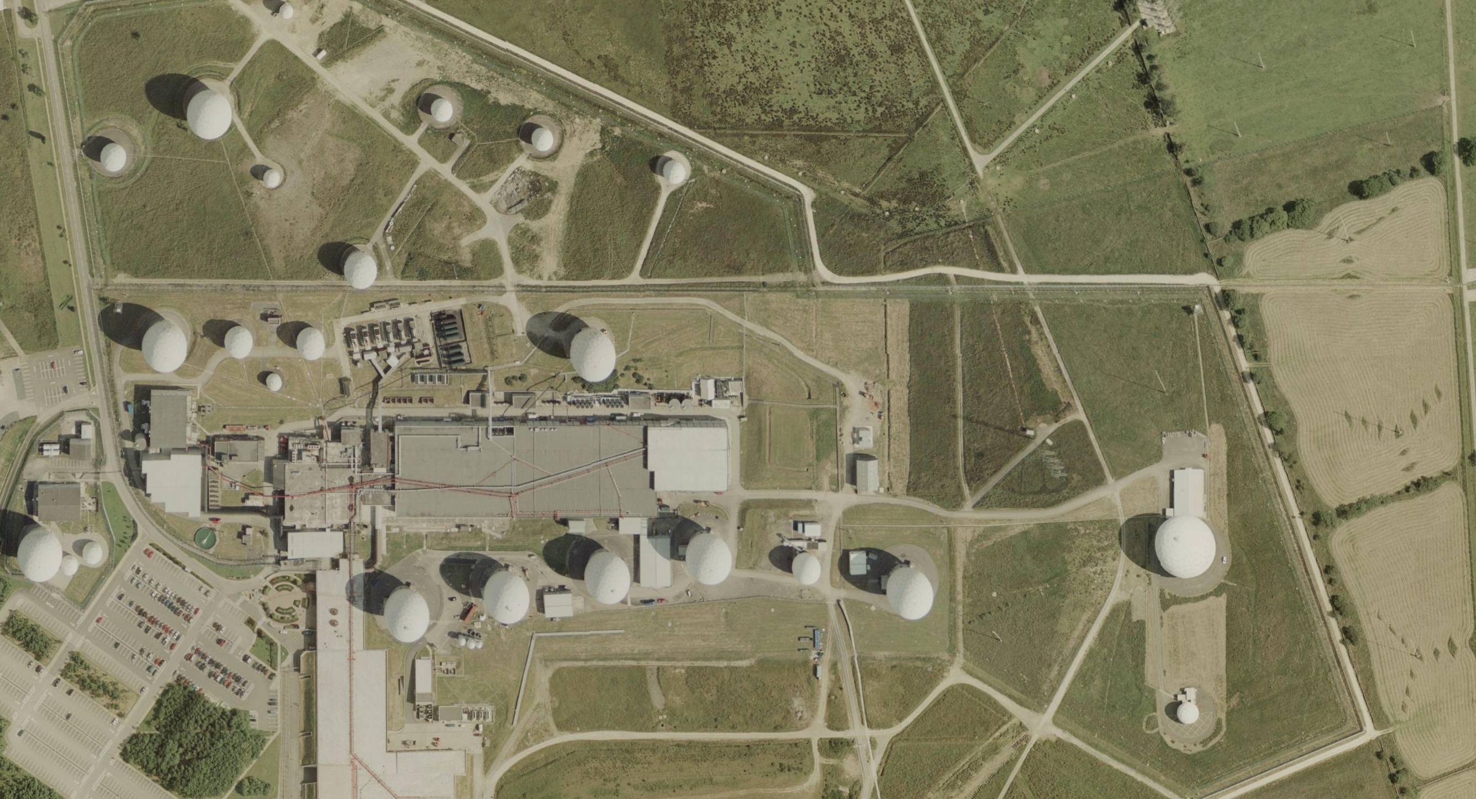
Parabola Antennas Farm : Echelon

Slide 32
Satellite Encryption
GEO-Mobile Radio Interface (GEO stands for Geostationary Earth Orbit), better known as GMR, is an ETSI standard for satellite phones. The GMR standard is derived from the 3GPP-family terrestrial digital cellular standards and supports access to GSM/UMTS core networks.
It is used by ACeS, ICO, Inmarsat, SkyTerra, TerreStar and Thuraya.There are two widely-deployed variants of GMR, both heavily modeled after GSM :
GMR-1: The first version of the standard and that has evolved over time into 3 different revisions:
GMR-1: The basic circuit switched model, more or less corresponding to what plain old GSM Phase 2 is, and using exactly the same core network infrastructure.
GmPRS: Adding support for packet data. The equivalent of GPRS in the GSM world. Still connected to a 'Gb' style core network.
GMR-1 3G: Adds support for some new channel types, but the most important changes are in the core network, adding interoperability with UMTS core network components. Contrary to the classic cell network where UMTS and GSM have a radically different air-interface, GMR-1 3G is still very similar to GMR-1 on the Layer 1 side.
GMR-2: Which is not an evolution of GMR-1 but rather a concurrent standard that has been developed by another group of companies.
GMR-1 is the technology used by Thuraya. GMR-1 3G is the technology used for TerreStar and SkyTerra. GMR-2 is used by Inmarsat iSatPhonePro. GMR was developed by TIA and ETSI.

Slide 33
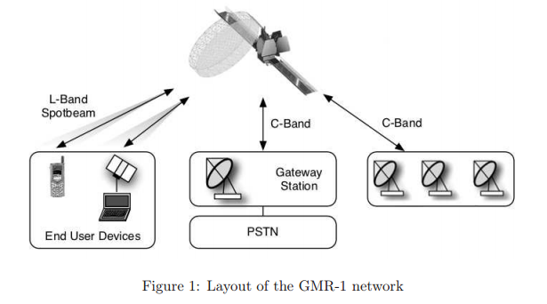
Satellite Encryption : Satellite Phone

Slide 34
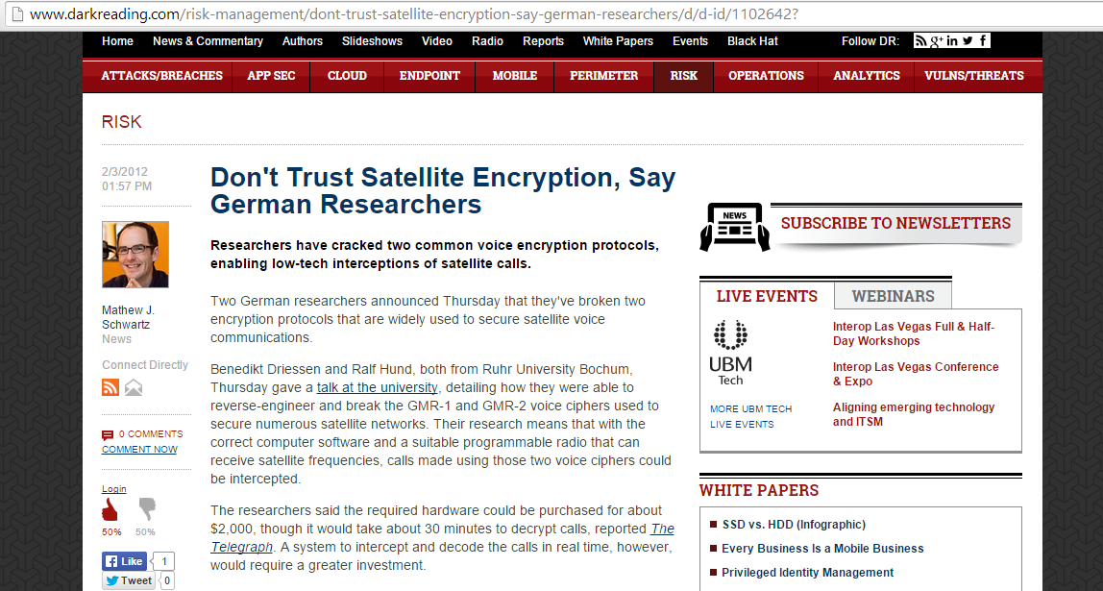
Don’t Trust Satellite Encryption

Slide 35
Experiment : Physical Layer of Link 16 Design

Slide 36
Link 16 JTIDS/MIDS System Description
JTIDS
MIDS
International Cooperation
Joint & Allied Interoperability
Open Architecture
State of the Art Technology
Acquisition Reform
Secure and Jam-Resistant Communications, Navigation and Identification System
Tactical Digital Data and Voice
Low Probability of Exploitation
User Identification
Relative Navigation
Inherent Relay Capability
Other Characteristics
Frequency Hopping over 51 different carrier frequencies
Utilizes Hybrid Direct Sequence and Frequency Hopping Spread Spectrum signals
Data Rates: 28.8 - 119.0 Kbps (error correction); ET proposes 1 Mbps
Omnidirectional broadcast
High Capacity
US DOD Primary data link
Many US allies also utilize Link 16
Nodeless
Frequency: 960-1215 MHz
Time Division Multiple Access (TDMA)
Multiple Voice Channels
Situational Awareness
Notes:
1

Slide 37
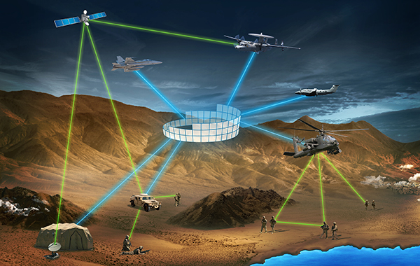
Link 16 JTIDS/MIDS System Description

Slide 38
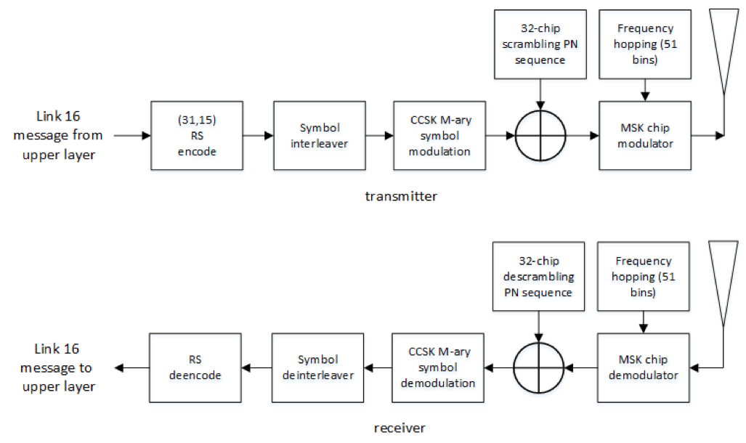
Physical Layer : Link 16
Link 16 implements a hybrid direct-sequence/frequency-hopping spread spectrum (FHSS) system, which means the transmit frequency is not held constant.
The frequency hopping occurs over 51 frequencies (also called bins).
Link 16 hops at a rate of 1/13 ms (76,923 hops per second)
Link 16 has 2 IFF notches centered at 1030 and 1090 MHz

Slide 39
Physical Layer : Link 16
Main components :
Channel Coding :
Reed Solomon
Combined with Interleaver
Modulation :
CCSK Modulation for LPI
MSK Modulation for cheap receiver
Spread Spectrum :
DSSS
FHSS

Slide 40
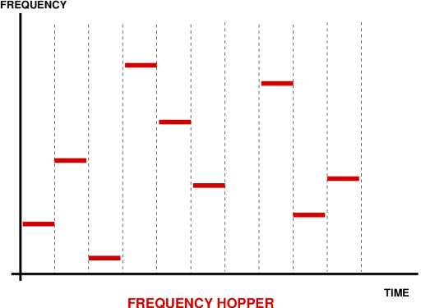
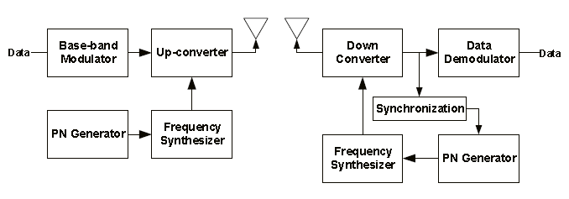
Transceiver FH-SS
Frequency-hopping spread spectrum (FHSS) is a method of transmitting radio signals by rapidly switching a carrier among many frequency channels, using a pseudorandom sequence known to both transmitter and receiver.

Slide 41
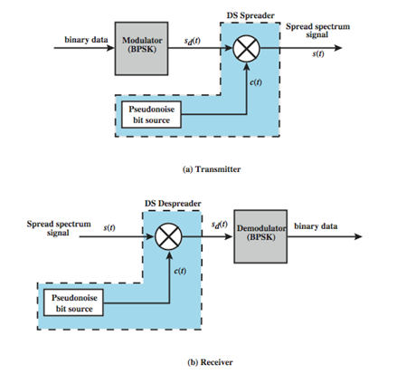
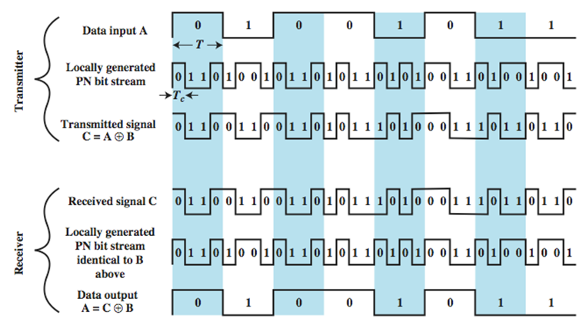
DSSS
Direct Sequence Spread Spectrum (DSSS) is a spread spectrum technique whereby the original data signal is multiplied with a pseudo random noise spreading code. This spreading code has a higher chip rate (this the bitrate of the code), which results in a wideband time continuous spreading signal.

Slide 42
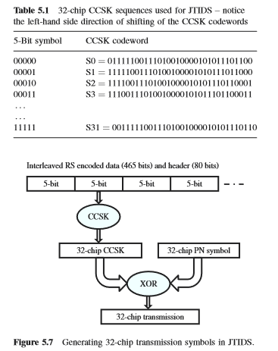
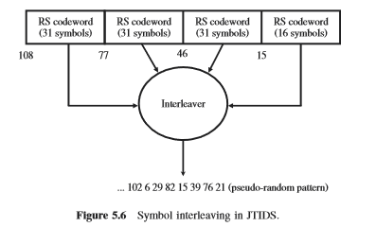
RS Code Interleaving and 32-Bit CCSK

Slide 43
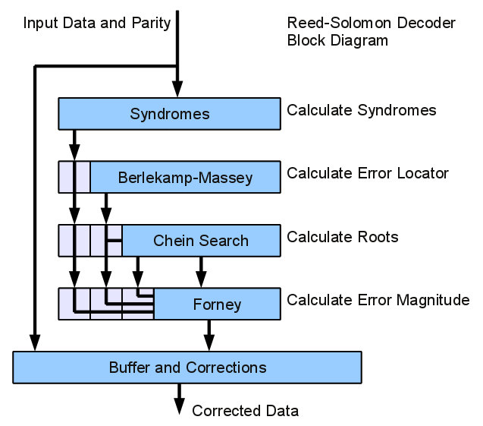
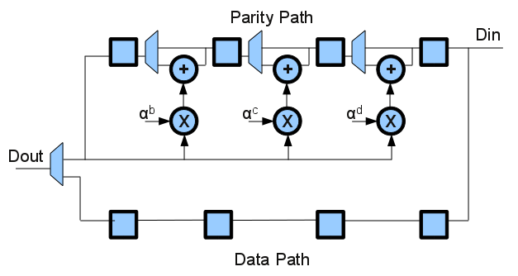
RS Encoder Decoder
In coding theory, Reed–Solomon (RS) codes are non-binary cyclic error-correcting codes invented by Irving S. Reed and Gustave Solomon. They described a systematic way of building codes that could detect and correct multiple random symbol errors. By adding t check symbols to the data, an RS code can detect any combination of up to t erroneous symbols, or correct up to ⌊t/2⌋ symbols.

Slide 44
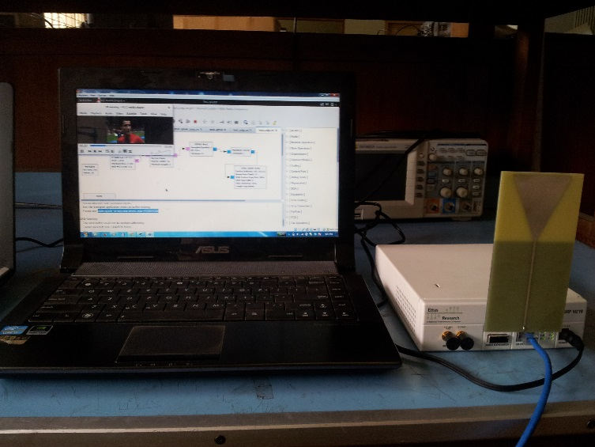
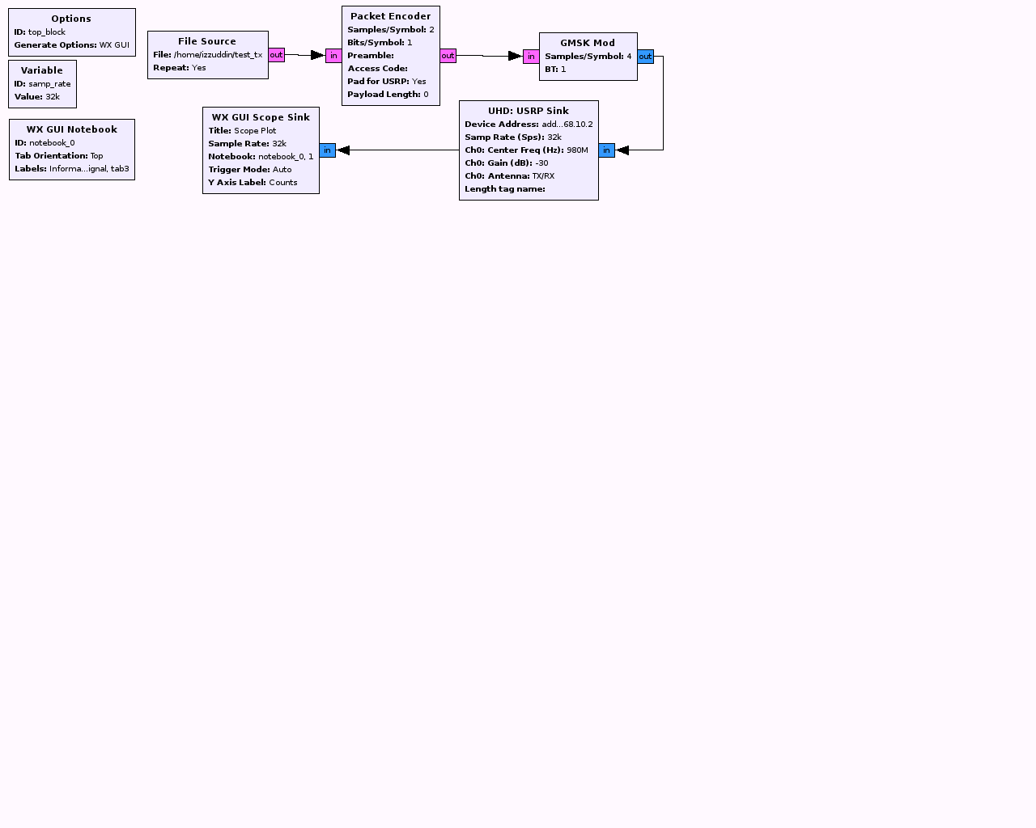
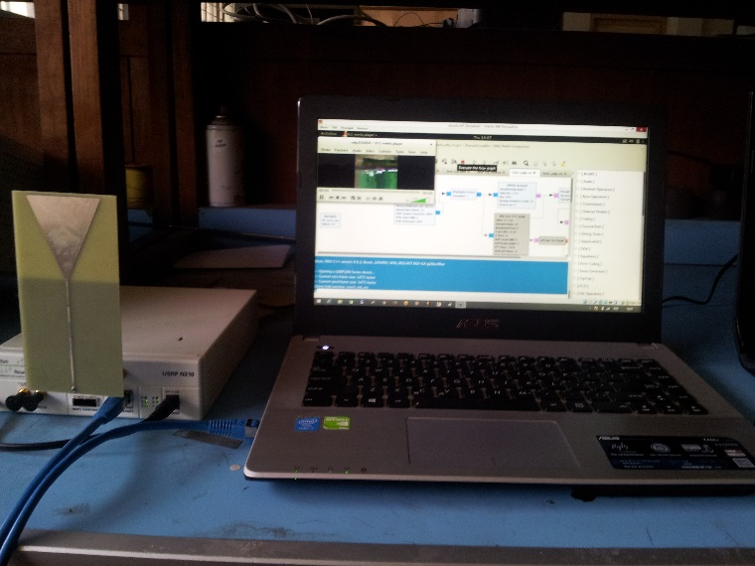
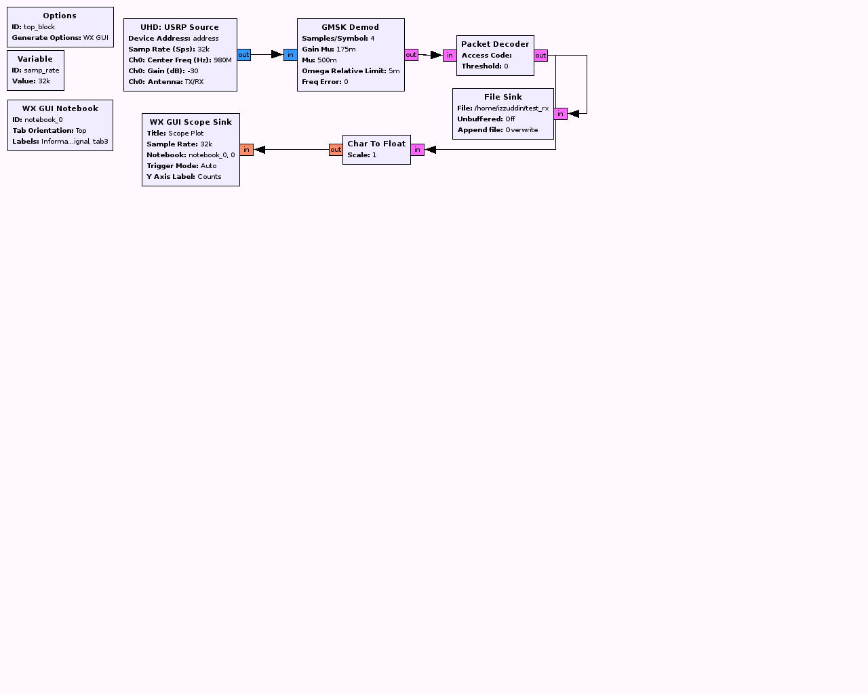
Link-16 Experiments : Tx and Rx

Slide 45
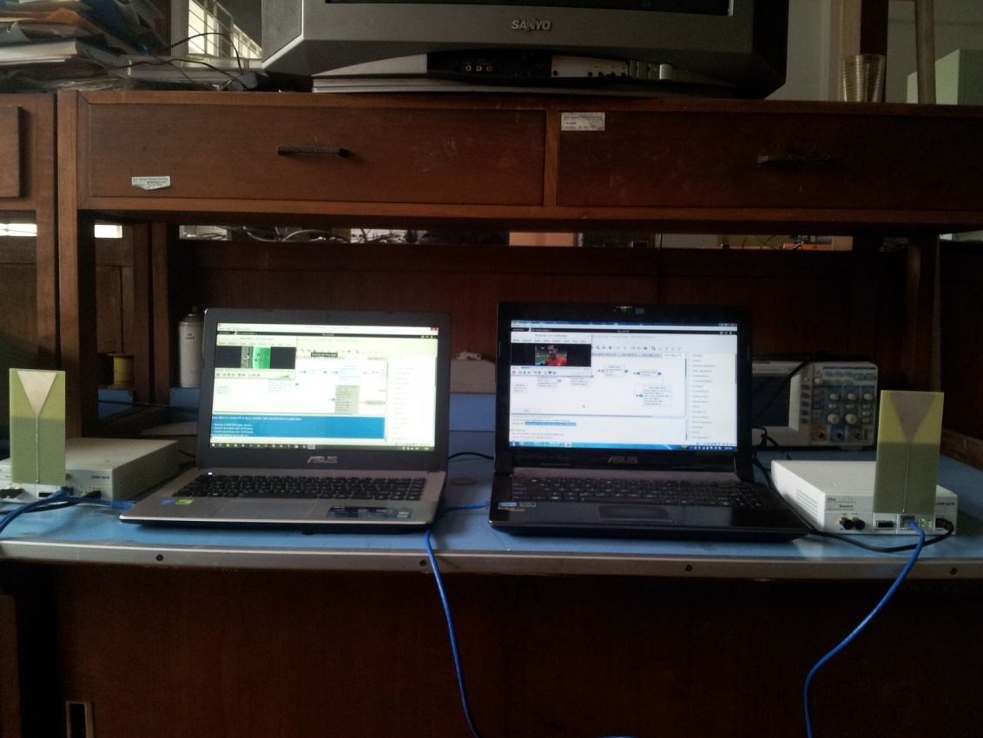
Link-16 Experiments : Video Streaming

Slide 46
Experiment : Chaotic-based Secure Videoconference over Satellite

Slide 47
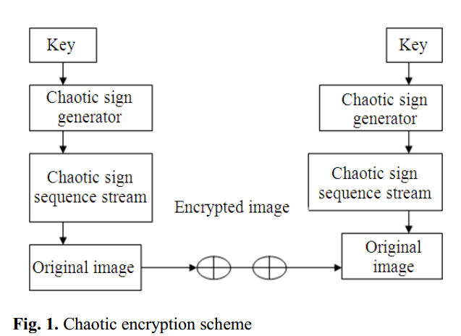
Generic Chaotic Encryption
The chaotic encryption method is proposed by Baptista, 1998.
It seems to be a much better encryption algorithm than traditional algorithms were used.
We first identify the mapping scheme for a trajectory to encrypt the message.
Subsequently decide the initial state and parameters for the key. We assume the initial condition as the current route (trajectory).
Iterate the chaotic equation until the path reaches the target site and then store the amount of iterations as a code for each message symbol.
Encrypt the next message by iterating the recent trajectory.
Produce the next cipher according it and so on.

Slide 48
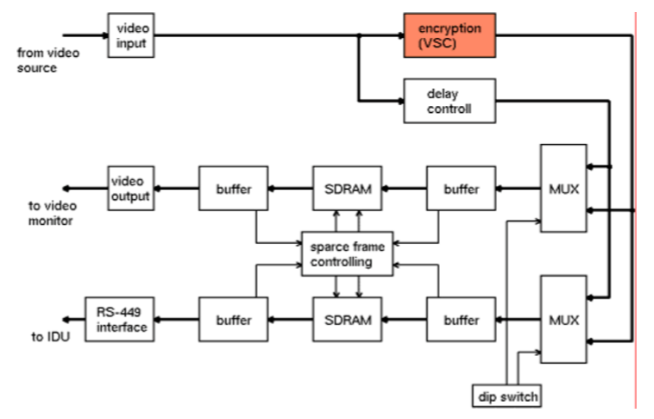
Chaotic-based Encryptor Module ( Tx )

Slide 49
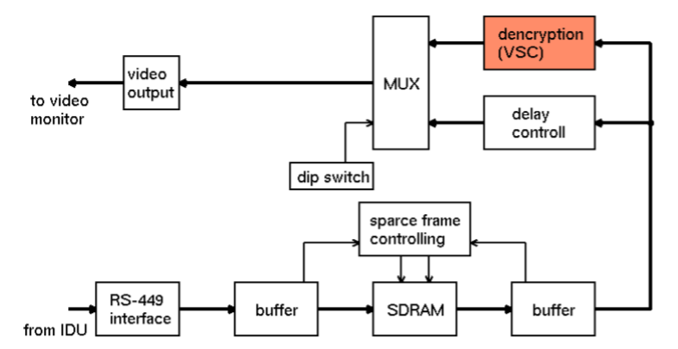
Chaotic-based Decryptor Module ( Rx )

Slide 50
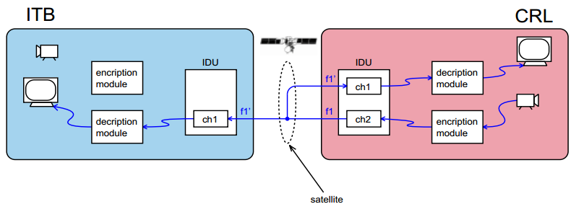
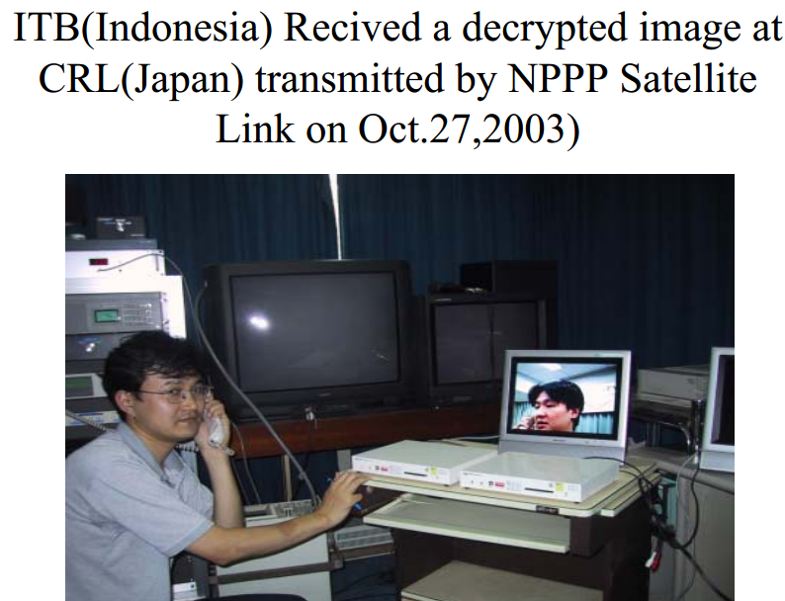
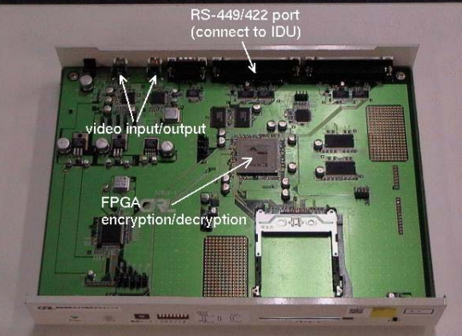
Experiment

